Slide 1
Decision Tree

Slide 2
What is a Decision Tree
Decision Tree is one of the well known and used supervised algorithms
It can be used for both Classification and Regression but generally used for Classification
As the name suggests, it is a Tree structured algorithm
Below are various part of Decision Tree
Root Node (where we start the decision tree)
Decision Node (where decision is being made)
Leaf Node (where no decision is made, tree is stopped)
Branches (values of features/variables)
Always prefer smaller trees, which have low depth

Slide 3
Play Tennis or not given 4 different variables/features
Outlook
Sunny
Rain
Overcast
Humidity
Yes
Wind
High
Strong
Weak
Normal
No
Yes
No
Yes
Outlook = Sunny
Temp = Hot
Humidity = High
Wind = Peak
Whether to play Tennis or Not ??

Slide 4
Questions to answer recursively
Whether to stop or continue splitting ?
If we don’t have further attributes/features/variables to split, we should stop
All the labels of the sub-set have same values – either “Yes” or “No”
Which attribute to split ?
Option # 1: Split the variable/feature which has low error
Option # 2: Split the variable which has low entropy

Slide 5
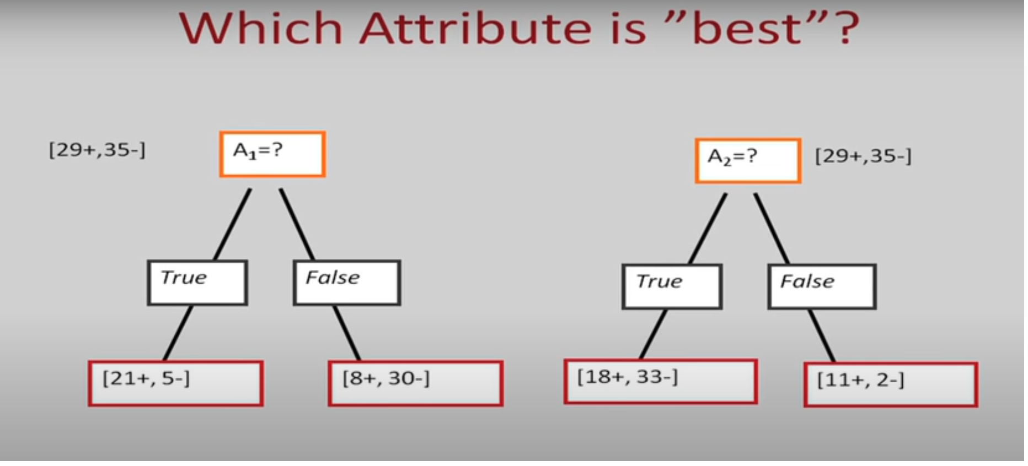

Slide 6
Entropy
Entropy is measure of data being disordered or measure of purity
If a node has all same values - either all “yes” or all “no”, then Entropy is 0
If a node has mix of “Yes” and “No”, Entropy is high
If a node has exactly 50% of “Yes” and 50% of “No”, Entropy is highest

